Slide 1


CIT 261
Mobile Development
XMLHTTPRequest
by Rafael Ferraz

Slide 2

AJAX

Slide 3
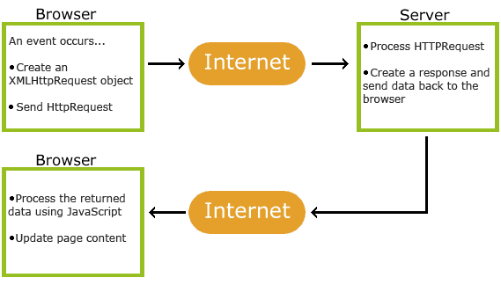
AJAX
AJAX = Asynchronous JavaScript And XML.

Slide 4
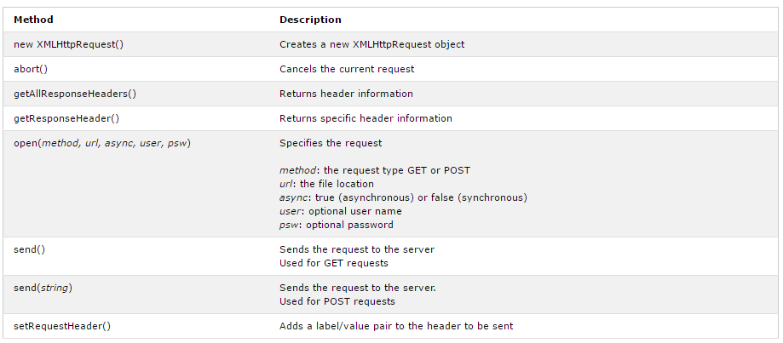
AJAX
The XMLHttpRequest object is used to exchange data with a server behind the scenes. This means that it is possible to update parts of a web page, without reloading the whole page.
variable = new XMLHttpRequest();

Slide 5
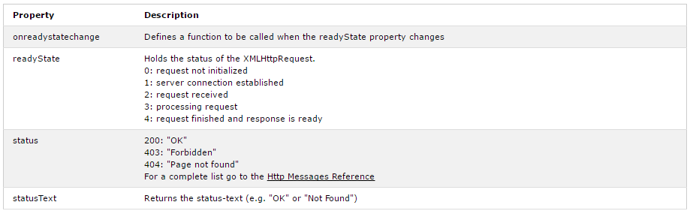
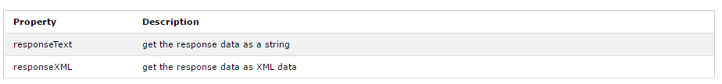
AJAX

Slide 6
CIT 261
Mobile Development
XMLHTTPRequest
THE END!
by Rafael Ferraz

